Slide 1


RL-VLM-F
VLM Score
CLIP Score
BLIP-2 Score

Slide 2
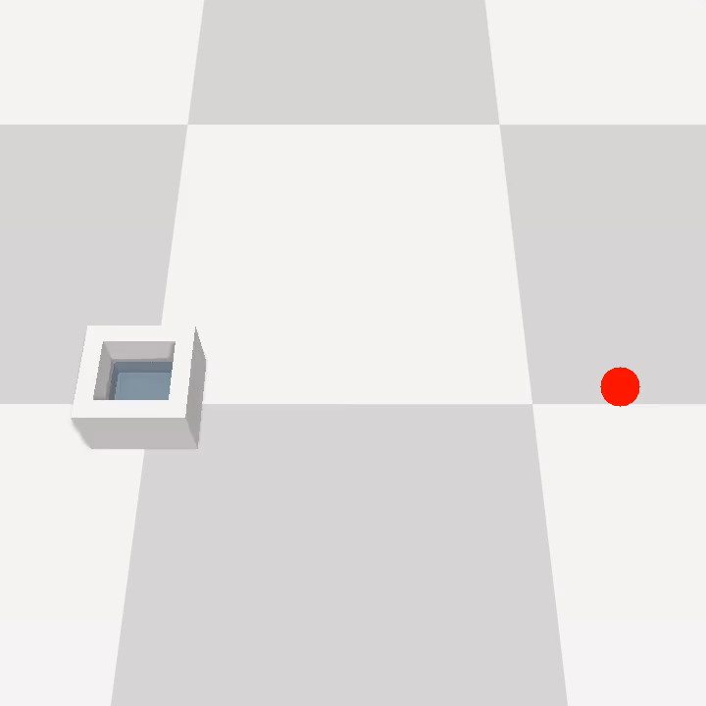



“Transport Water without Spilling”
RL-VLM-F
VLM Score
CLIP Score
BLIP-2 Score

Slide 3




“Straighten Rope”
RL-VLM-F
VLM Score
CLIP Score
BLIP-2 Score

Slide 4
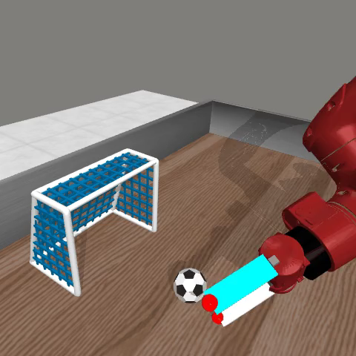



“Move Soccer Ball into Goal”
RL-VLM-F
VLM Score
CLIP Score
BLIP-2 Score

Slide 5
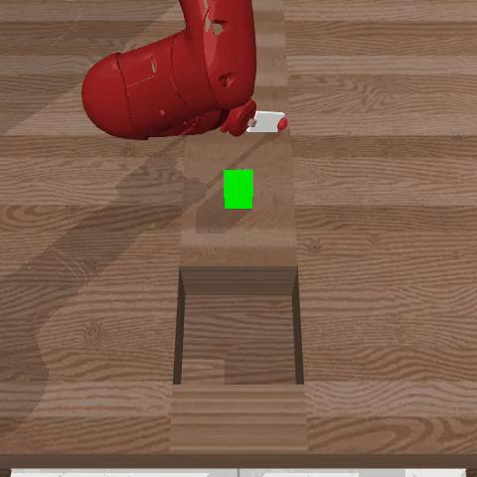

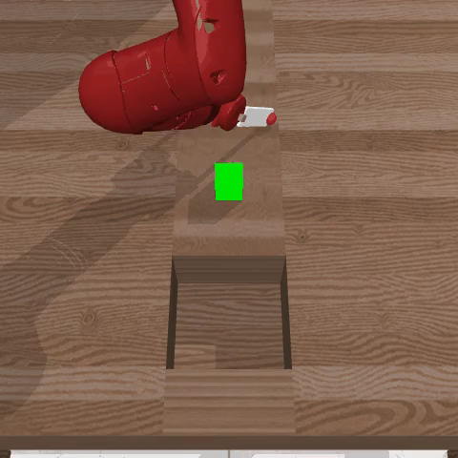
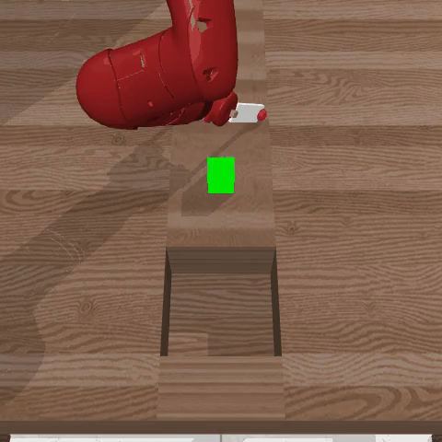
“Sweep Cube into Hole”
RL-VLM-F
VLM Score
CLIP Score
BLIP-2 Score

Slide 6
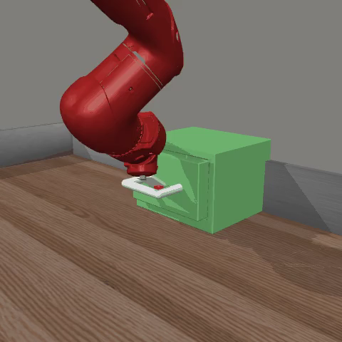



“Open Drawer”
RL-VLM-F
VLM Score
CLIP Score
BLIP-2 Score

Slide 7
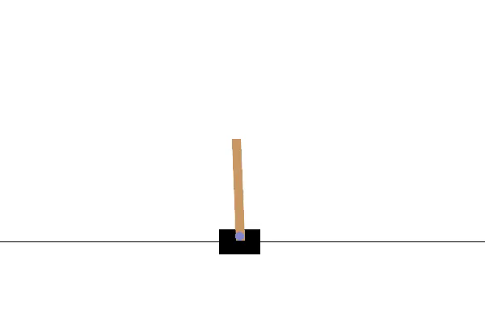
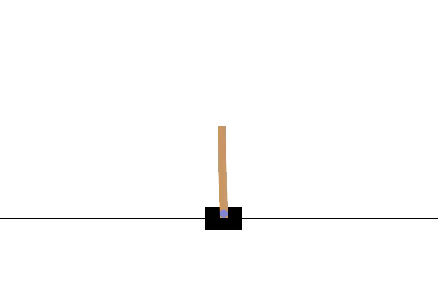
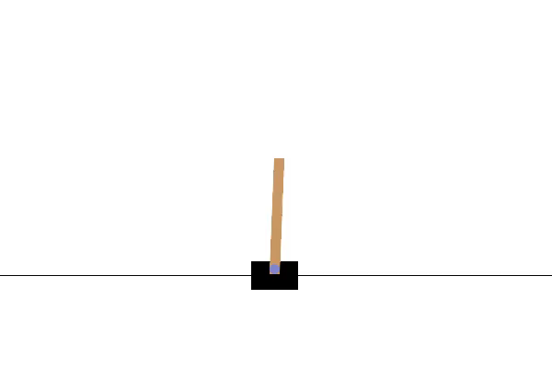
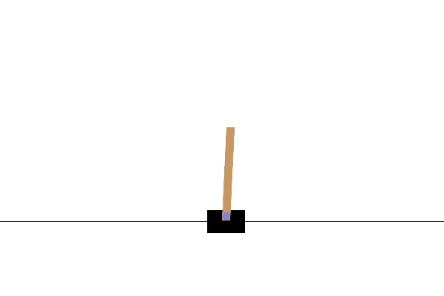
RL-VLM-F
VLM Score
CLIP Score
BLIP-2 Score

Slide 8
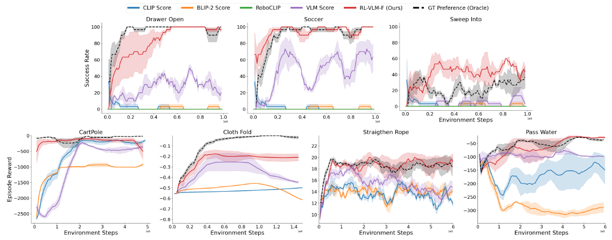
Learning Curves of all Compared Methods
RL-VLM-F greatly outperforms other methods!

